Slide 1
Recursive Bayes Filters and related models for mobile robots

Slide 2
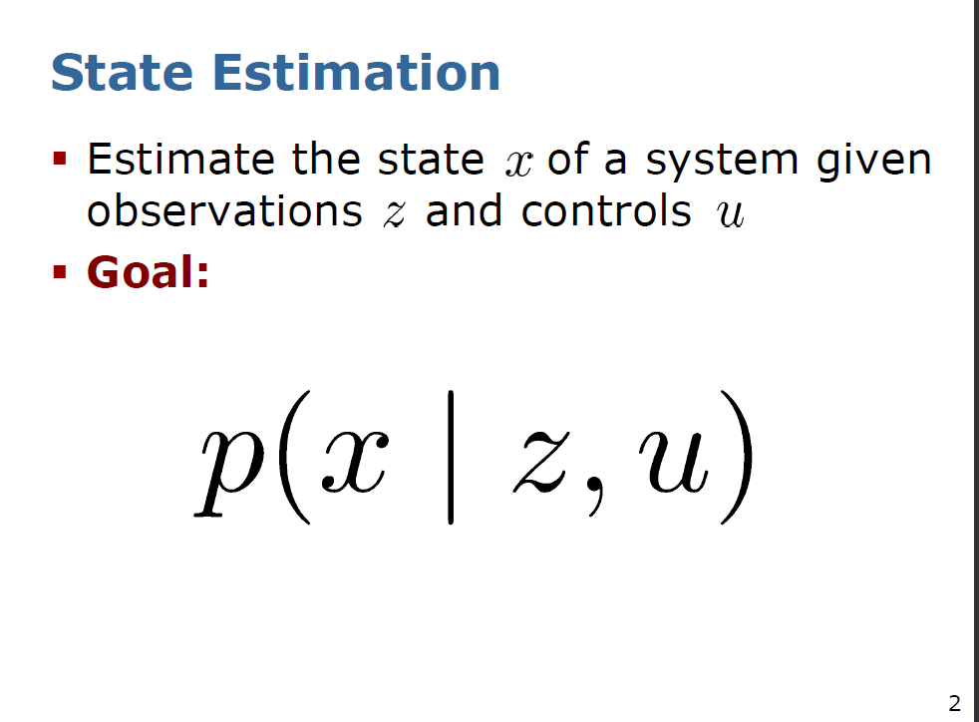

Slide 3
Recursive Bayes Filters
We will briefly review our derivation of Bayes filter from one of previous lectures first.

Slide 4
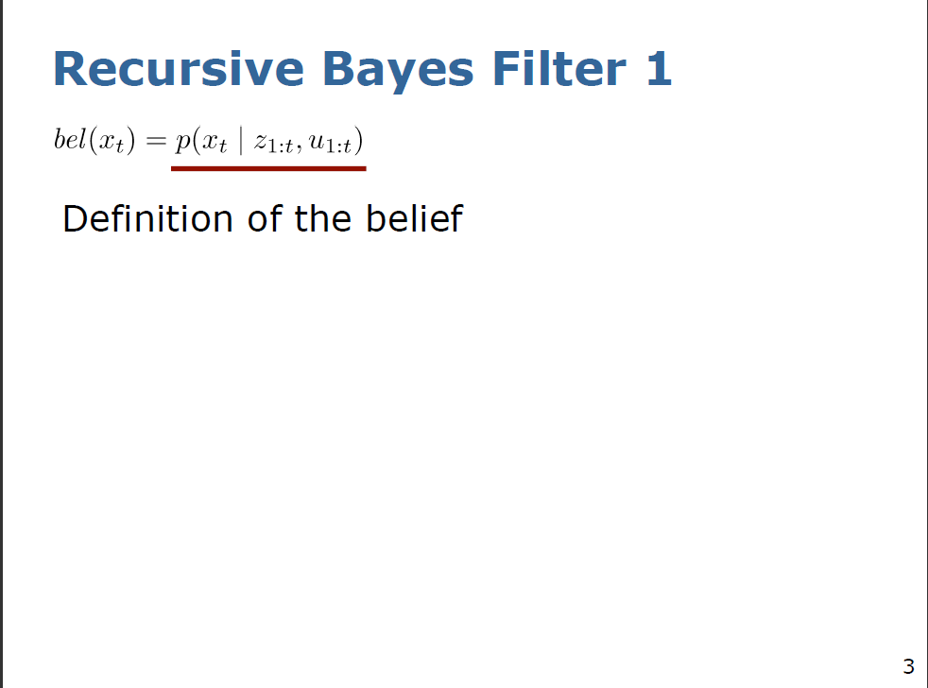

Slide 5
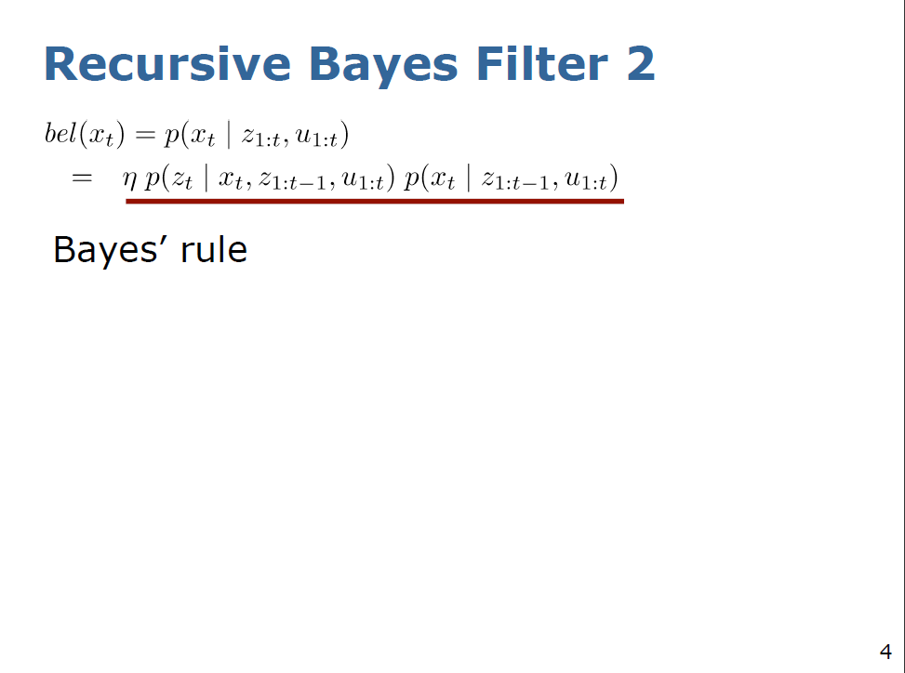

Slide 6
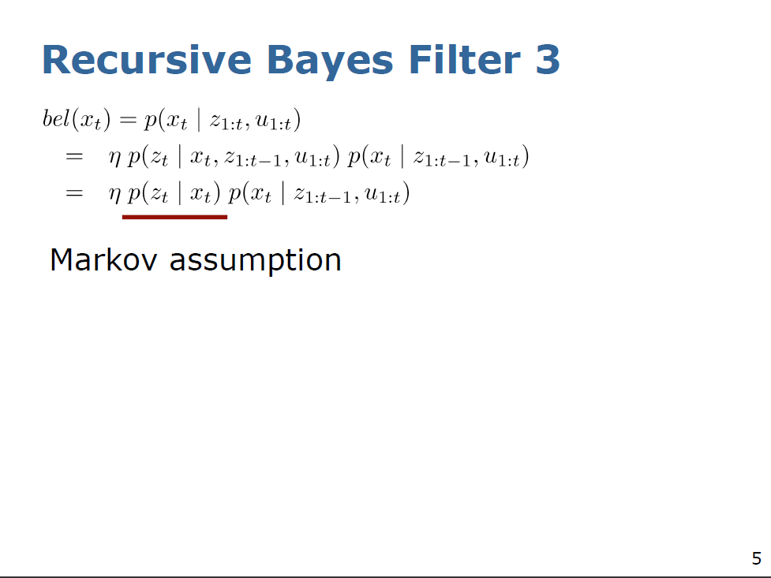

Slide 7
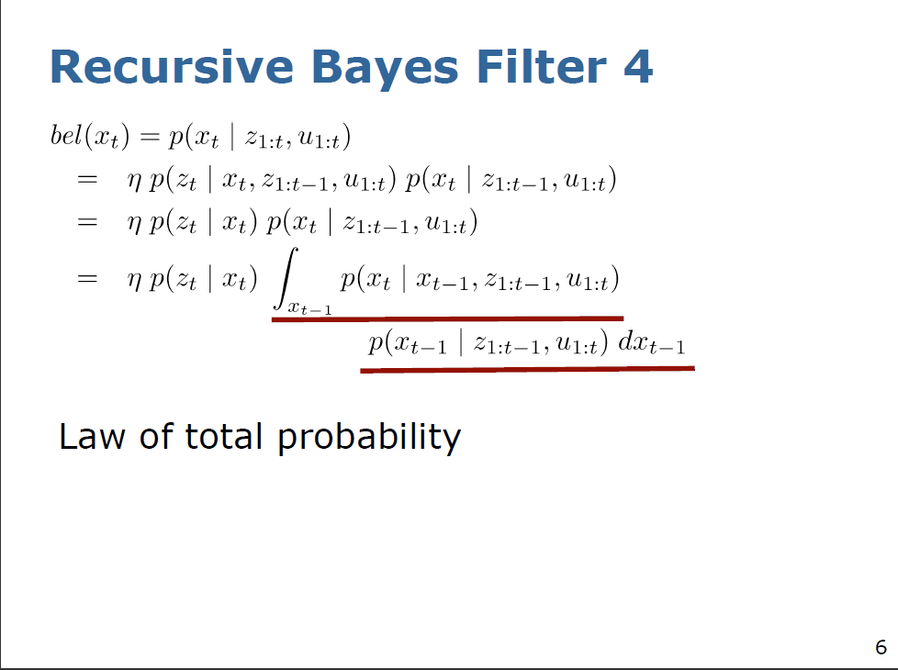

Slide 8
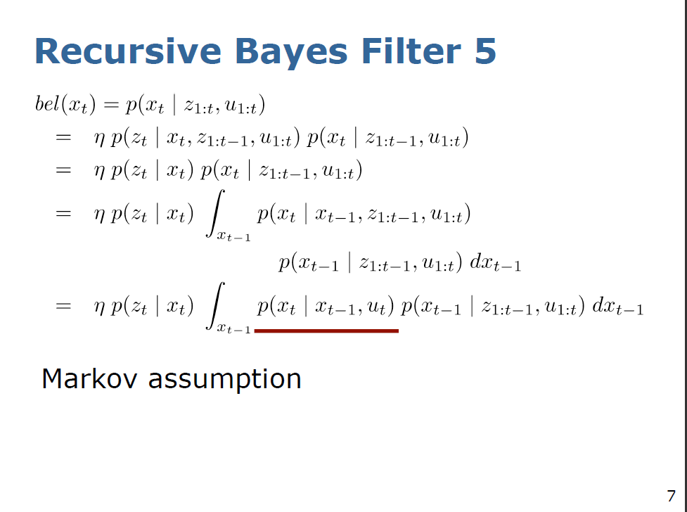

Slide 9
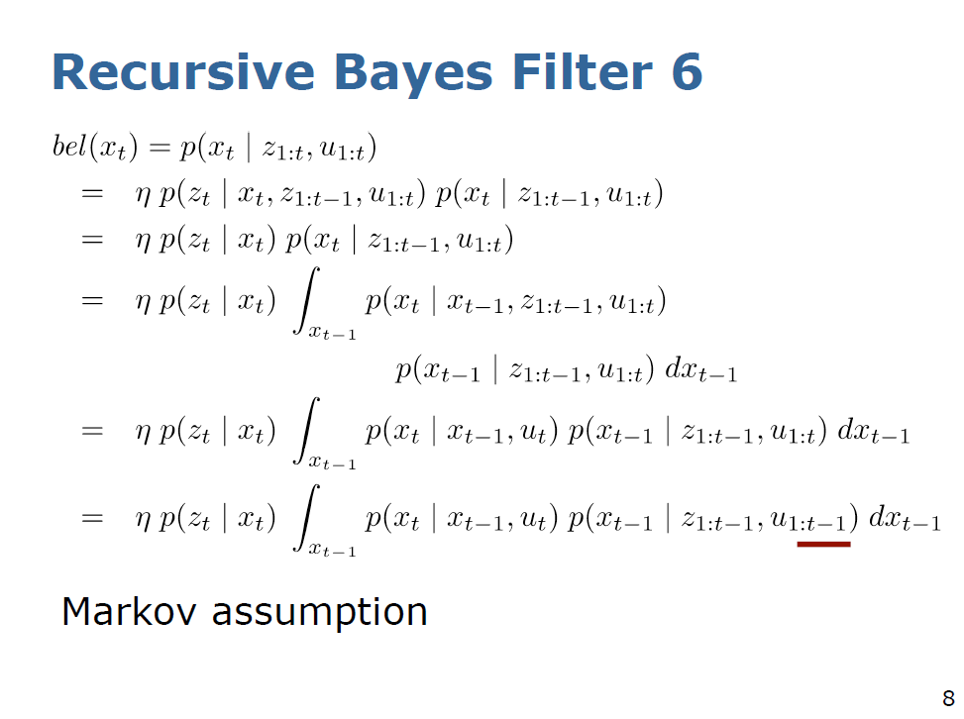

Slide 10
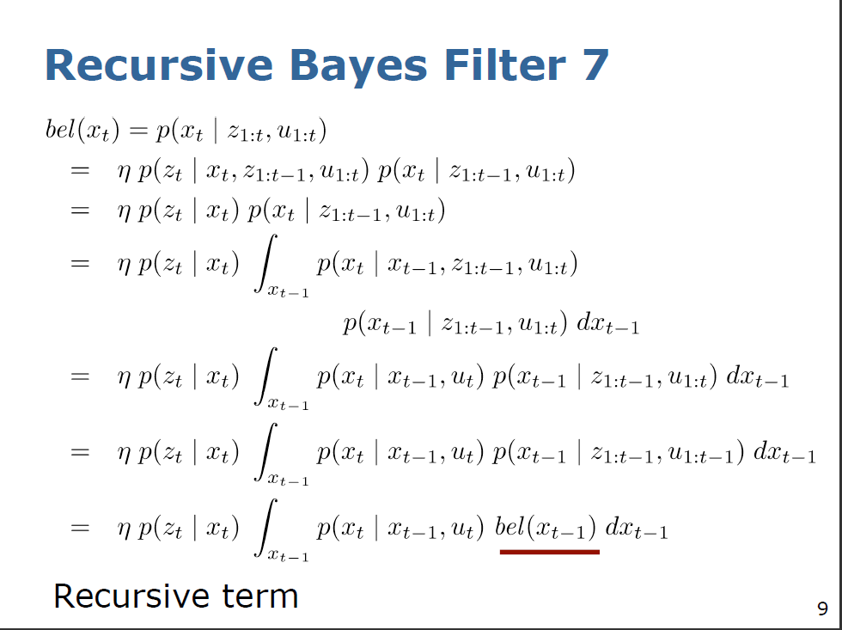

Slide 11
Two steps of Bayes filter: Prediction and Correction

Slide 12
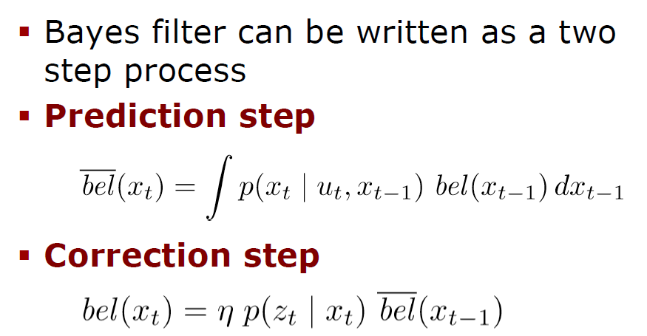
Two steps of Bayes filter: Prediction and Correction
From odometry and equations of motion
control
Use measurement to correct

Slide 13
Both the prediction step and the correction step use the following:
  Motion model
  Sensor or observation model

Slide 14
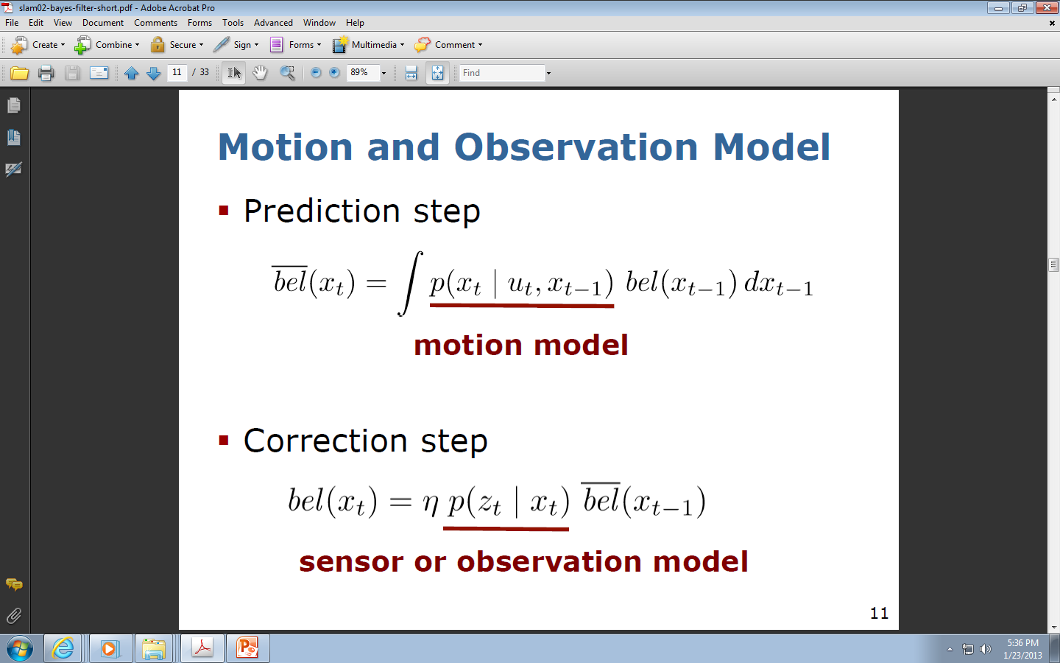
Formulas from previous slide

Slide 15
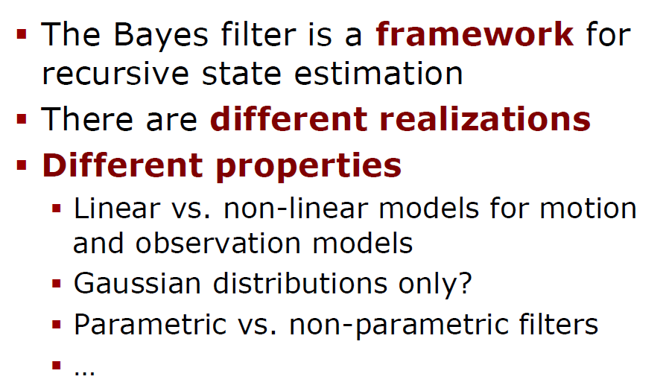
Different Realizations of Bayes Filters
Recursive filters

Slide 16
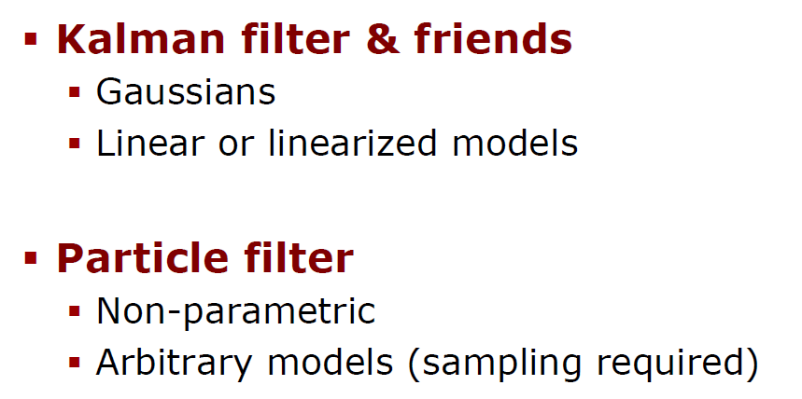
Main Approaches to Bayes Filters
Similar methods based on Bayesian probability, networks, and evolutionary algorithms also exist

Slide 17
Probabilistic Motion Models

Slide 18
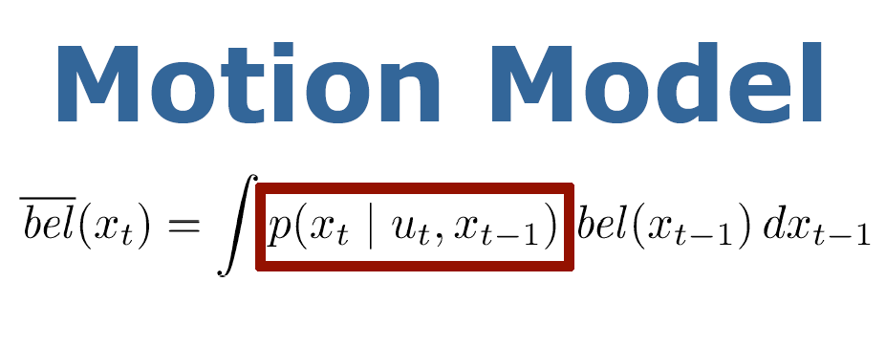

Slide 19
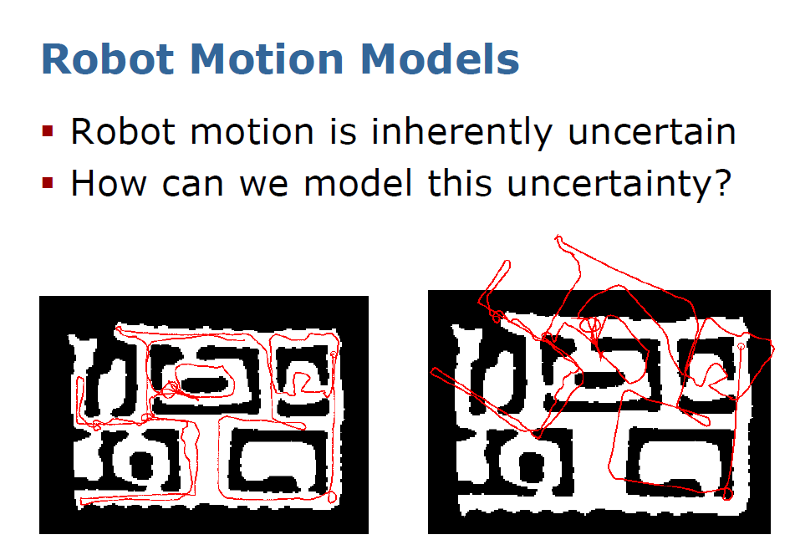
Using only odometry in long run is definitely wrong

Slide 20
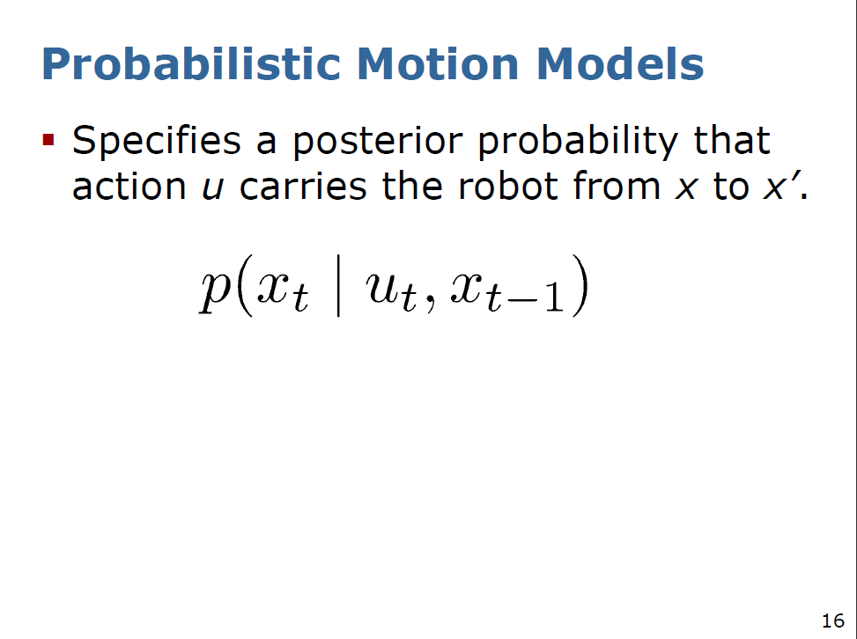
Explain the meaning

Slide 21
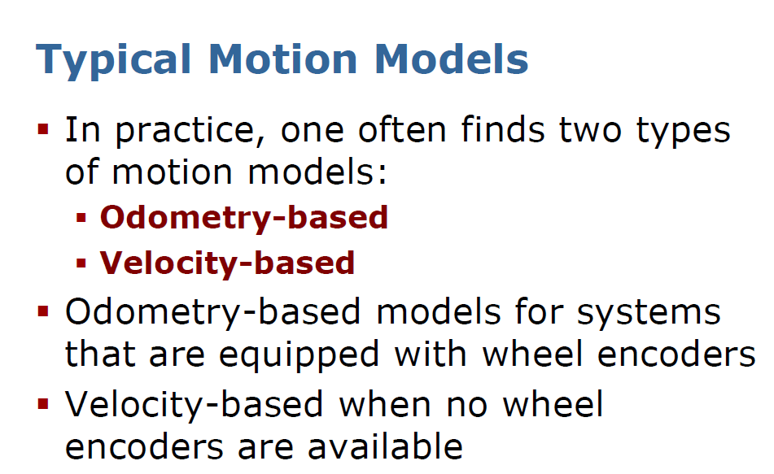
In past we used velocity models for simple Braintenberg Vehicles
For MCECSBOT we will have to use perhaps the odometry-based model

Slide 22
Motion Model based on ODOMETRY

Slide 23
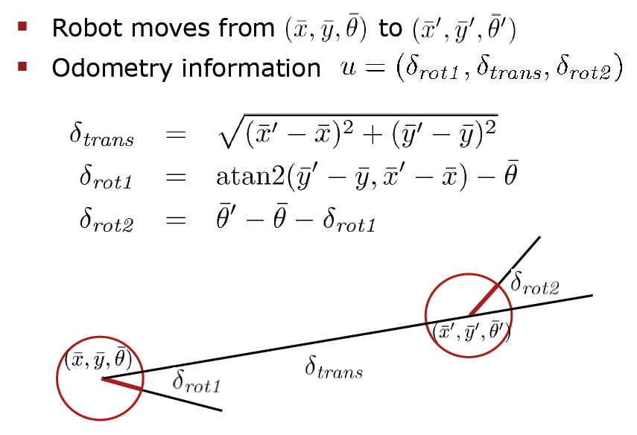
Motion Model for a robot based on ODOMETRY
This model will be more complicated for OMNI and MECCANO WHEELS

Slide 24
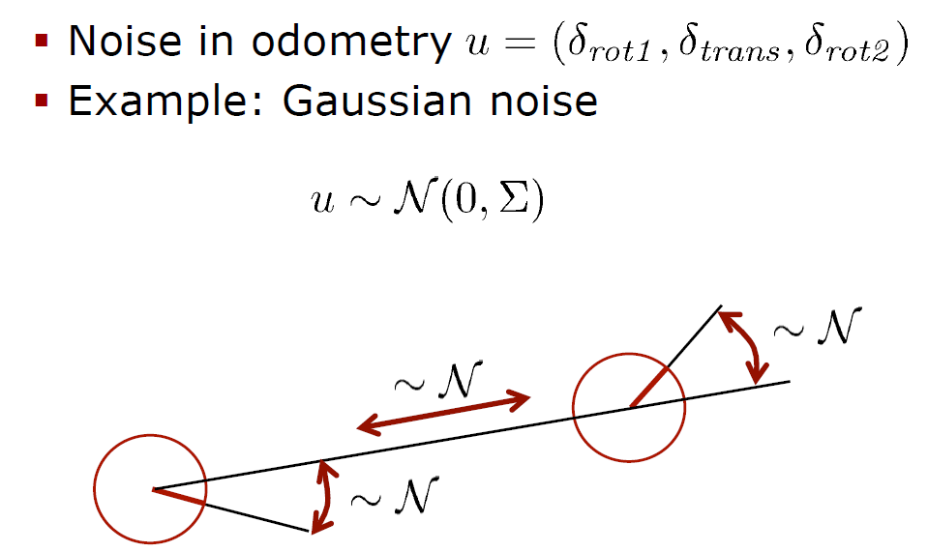
Probability Distribution in Motion Model for a robot based on ODOMETRY

Slide 25
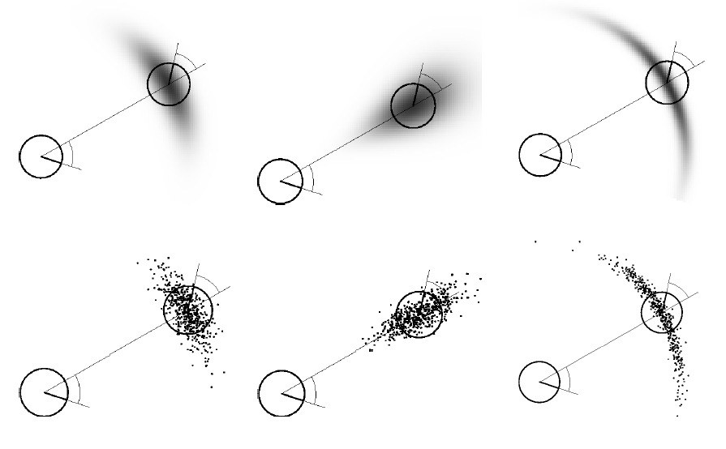
Examples of Odometry-Based noise

Slide 26
Velocity Based Motion Models for a robot

Slide 27
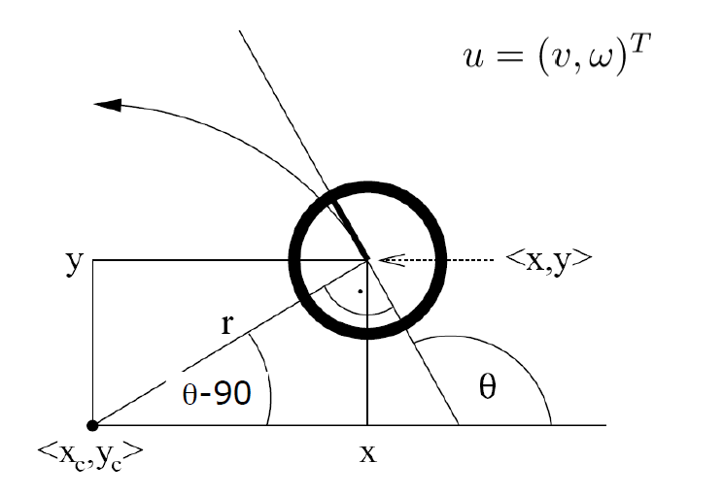
Velocity Based Motion Models for a robot
Explain the meaning
It is easy to derive such model for a two-wheeled robot
We have done it as part of kinematics explanation in Fall quarter (for non-deterministic case).

Slide 28
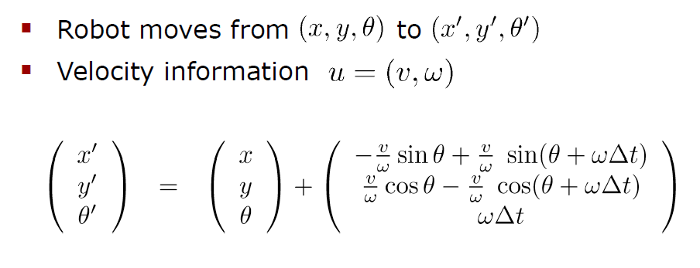
Motion Equation for Velocity Based Motion Models for a robot

Slide 29
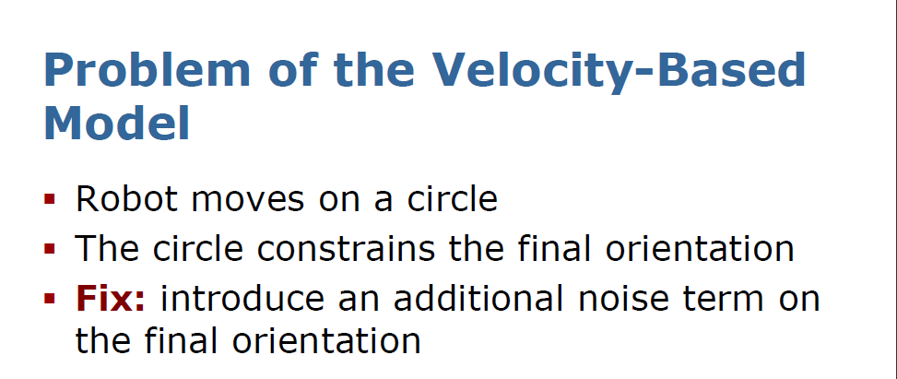
We add an additional noise term now.

Slide 30
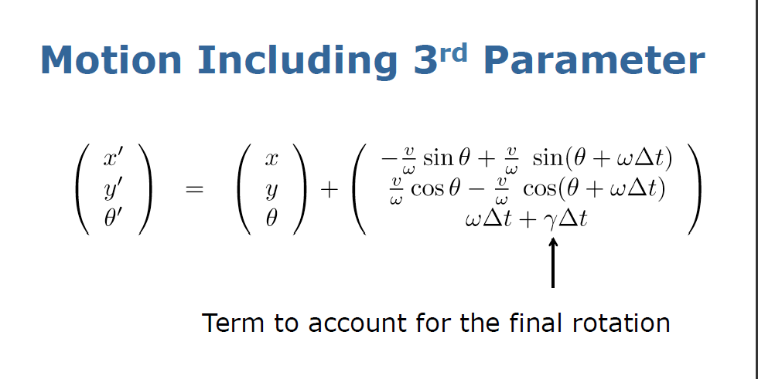
Here we fix the problem outlined in the previous slide

Slide 31
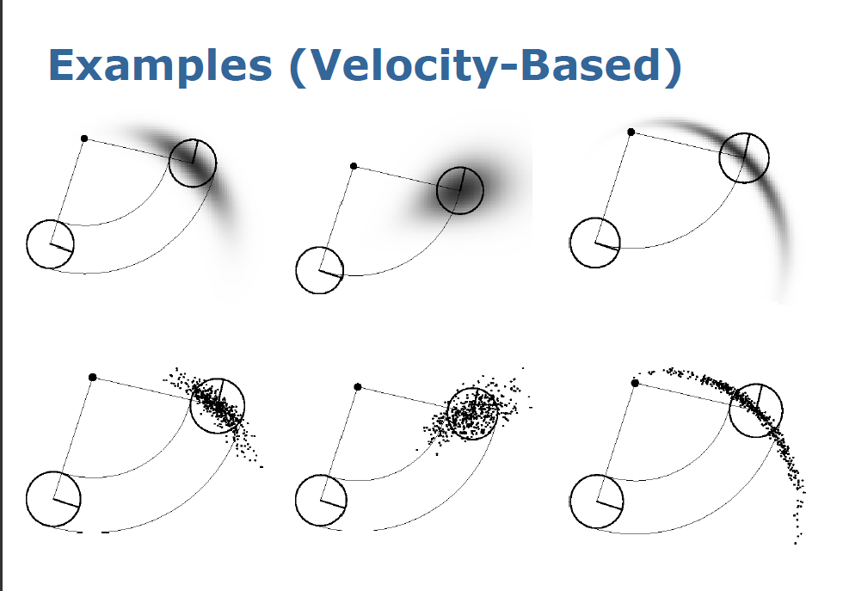
The dark clouds represent probability density
The dots represent samples of probability
Moving on circles

Slide 32
Sensor
Models

Slide 33
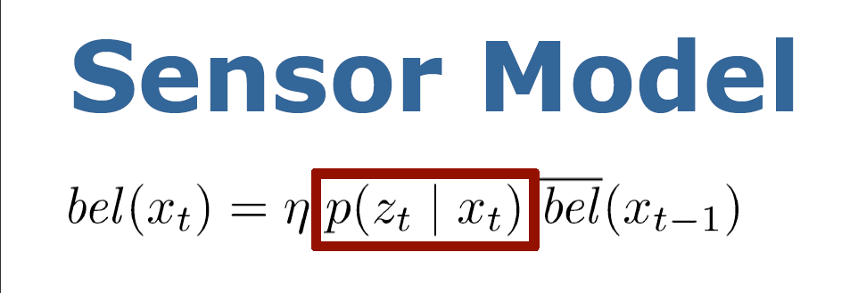

Slide 34
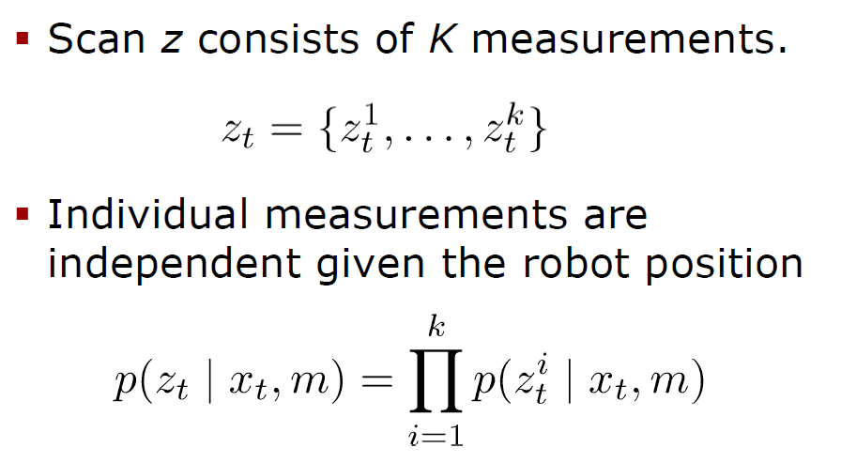
Sensor model for Laser Scanners

Slide 35
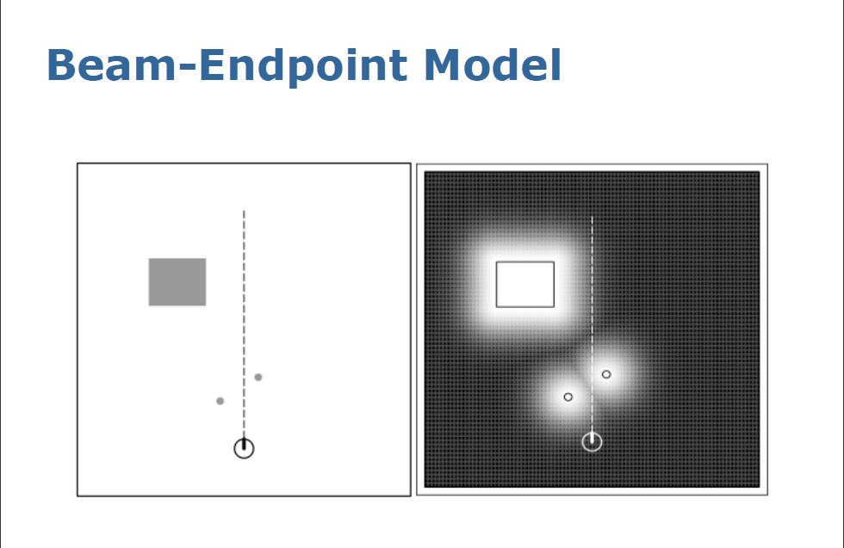
You do not need to know too much if you are small and only want to move straight ahead

Slide 36
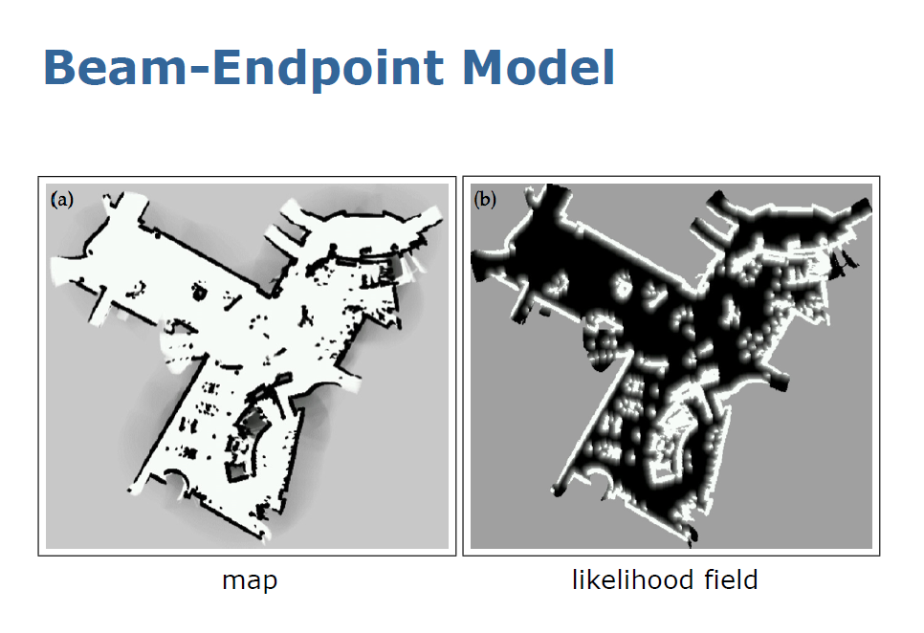

Slide 37
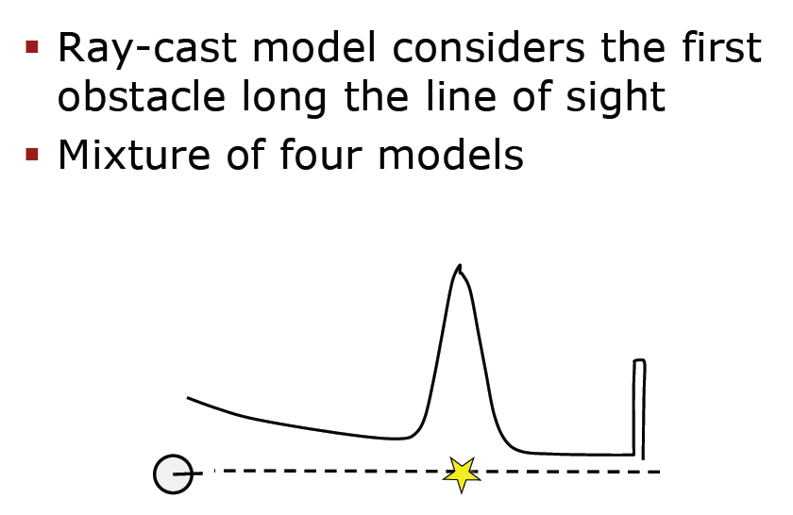
Ray Cast Sensor Model

Slide 38
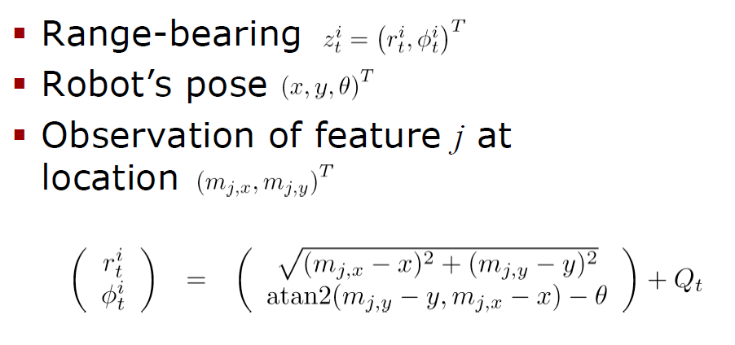
Feature-based Model for Range-Bearing Sensors
error

Slide 39
Summary
Bayes Filter is a framework for state estimation
Motion model and sensor model are the central models in Bayes Filter
These are all standard models for:
  Robot motion
  Laser-based range sensing
  Similar sensors

Slide 40
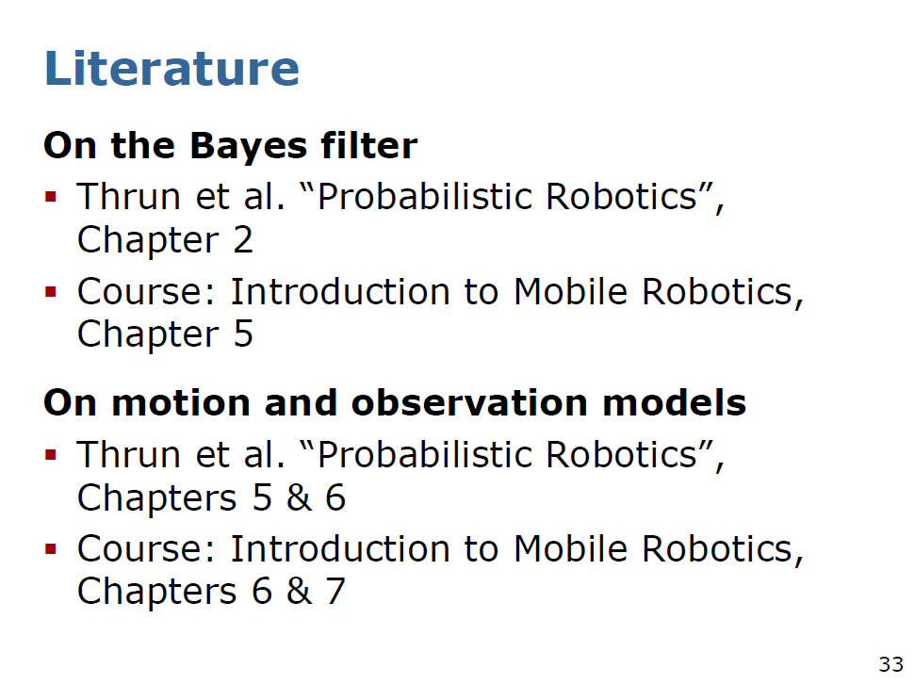

Slide 42
